Slide 1
Instagram Database Clone
Yingna Lu

Slide 2
Let’s clone Instragram
Focus on designing
the schema

Slide 3
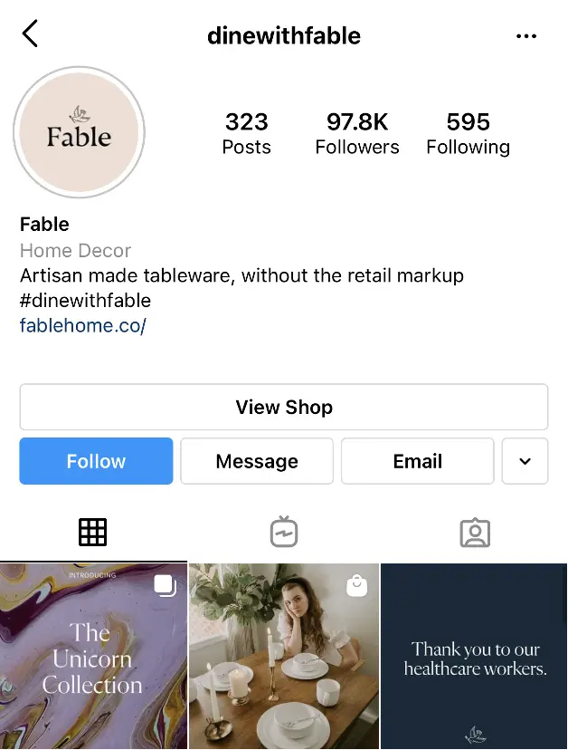
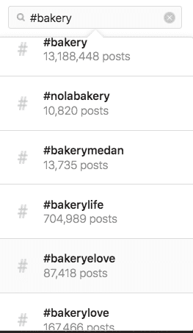
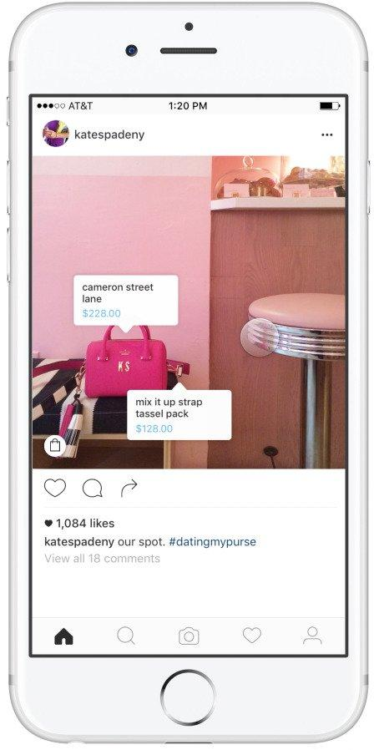

Slide 4
Users
Comments
Hashtags
Photos
Likes
Followers/Followees

Slide 5
Let’s Start With Users
Users
ID (Primary Key)
Username
Created_at
When the user signs up, it will have a default value of now or current timestamp username.
ID will be a primary key and will be referencing this ID and other places.
For example, photos. I can have a foreign key referencing the user ID.

Slide 6
import sqlite3
conn = sqlite3.connect('Instagram.db')
print("Opened database successfully");
conn.execute('''
CREATE TABLE IF NOT EXISTS INS_Users(
id INTEGER PRIMARY KEY AUTOINCREMENT,
username VARCHAR(100) UNIQUE NOT NULL,
created_at TIMESTAMP DEFAULT CURRENT_TIMESTAMP);''')
conn.commit()
print("Table created successfully");
conn.close()

Slide 7
Photos
Users
ID (Primary Key)
Username
Created_at
Photos
ID
Image_url
Iser_ID (Foregin Key)
Created_at
Photo’s foreign key Photos.user_id pointing to users.ID.

Slide 8
conn = sqlite3.connect('Instagram.db')
conn.execute('PRAGMA foreign_keys = ON;')
print("Opened database successfully");
conn.execute('''
CREATE TABLE IF NOT EXISTS Photos(
id INTEGER PRIMARY KEY AUTOINCREMENT,
image_url VARCHAR(100) UNIQUE NOT NULL,
user_id INTEGER NOT NULL ,
created_at TIMESTAMP DEFAULT CURRENT_TIMESTAMP,
CONSTRAINT fk_user_id FOREIGN KEY(user_id) REFERENCES INS_Users(id));''')
conn.commit()
print("Table created successfully");
conn.close()

Slide 9
Comments
Users
ID (Primary Key)
Username
Created_at
Comments
ID
Comment_text
User_ID (Foregin Key)
Photo_ID(Foregin Key)
Created_At
Photos
ID
Image_url
User_ID (Foregin Key)
Created_at

Slide 10
conn = sqlite3.connect('Instagram.db')
conn.execute('PRAGMA foreign_keys = ON;')
print("Opened database successfully");
conn.execute('''
CREATE TABLE IF NOT EXISTS Comments(
id INTEGER PRIMARY KEY AUTOINCREMENT,
comment_text VARCHAR(100) UNIQUE NOT NULL,
user_id INTEGER NOT NULL ,
photo_id INTEGER NOT NULL,
created_at TIMESTAMP DEFAULT CURRENT_TIMESTAMP,
CONSTRAINT fk_user_id FOREIGN KEY(user_id) REFERENCES INS_Users(id),
CONSTRAINT fk_photo_id FOREIGN KEY(photo_id) REFERENCES Photos(id));''’)
conn.commit()
print("Table created successfully");
conn.close()

Slide 11
What About Likes?
Users
ID (Primary Key)
Username
Created_at
Photos
ID
Image_url
User_ID (Foregin Key)
Created_at
Likes
User_id(Foregin Key)
Photo_id(Foregin Key)
Created_at

Slide 12
conn = sqlite3.connect('Instagram.db')
print("Opened database successfully");
conn.execute('''
CREATE TABLE IF NOT EXISTS Likes(
user_id INTEGER NOT NULL,
photo_id INTEGER NOT NULL,
created_at TIMESTAMP DEFAULT CURRENT_TIMESTAMP,
FOREIGN KEY(user_id) REFERENCES Users(id),
FOREIGN KEY(Photo_id) REFERENCES Photos(id),
PRIMARY KEY(User_id, Photo_id));''')
conn.commit()
print("Table created successfully");
conn.close()

Slide 13
Followers & Followees
Users
ID (Primary Key)
Username
Created_at
Follows
Follower_id (Foregin Key)
Followee_id (Foregin Key)
Created_at

Slide 14
conn = sqlite3.connect('Instagram.db')
print("Opened database successfully");
conn.execute('''CREATE TABLE IF NOT EXISTS Follows (
follower_id INTEGER NOT NULL,
followee_id INTEGER NOT NULL,
created_at TIMESTAMP DEFAULT CURRENT_TIMESTAMP,
FOREIGN KEY(follower_id) REFERENCES Users(id),
FOREIGN KEY(followee_id) REFERENCES Users(id),
PRIMARY KEY(follower_id, followee_id));''')
conn.commit()
print("Table created successfully");
conn.close()

Slide 15
HashTag
*Tag name need to be unique.
Photos Tags Photo_Tags
Id Image_url Caption
1 /’safa2323’ ‘My meal’
Id Tag_name
1 ‘#good’
2 ‘#yummy’
Photo_ID Tag_ID
1 1
1 2
Table Photo_Tags has two foregin key: one pointing to photo.id, one poinintg to tags.id.

Slide 16
conn = sqlite3.connect('Instagram.db')
print("Opened database successfully");
conn.execute('''CREATE TABLE Tags (
id INTEGER AUTO_INCREMENT PRIMARY KEY,
tag_name VARCHAR(255) UNIQUE,
created_at TIMESTAMP DEFAULT CURRENT_TIMESTAMP);''')
conn.execute('''CREATE TABLE Photo_tags (
photo_id INTEGER NOT NULL,
tag_id INTEGER NOT NULL,
FOREIGN KEY(photo_id) REFERENCES photos(id),
FOREIGN KEY(tag_id) REFERENCES tags(id),
PRIMARY KEY(photo_id, tag_id));''')
conn.commit()
print("Table created successfully");
conn.close()

Slide 17
Finding 5 Oldest Users
SELECT *
FROM Users
ORDER BY Created_at
LIMIT 5;

Slide 18
Most Popular Registration Date
SELECT
DAYNAME(created_at) AS day,
COUNT(*) AS total
FROM Users
GROUP BY day
ORDER BY total DESC
LIMIT 2

Slide 19
Identify Inactive Users(users with no photo)
SELECT username
FROM Users
LEFT JOIN Photos
on Users.Id=Photos.user_id
WHERE Photos.id IS NULL;

Slide 20
Identify Most Popluar Photo(and user who created it)
SELECT
username,
Photos.id,
Photos.image_url,
COUNT(*) AS total
FROM photos
INNER JOIN likes
ON Likes.photo_id=Photos.id
INNER JOIN users
ON Photos.user_id=Users.id
GROUP BY Photos.id
ORDER BY total DESC
LIMIT 1;

Slide 21
Calcuate Average Number of Photos Per User
SELECT (SELECT Count(*)
FROM Photos) / ( SELECT Count (*)
FROM Users) AS avg;

Slide 22
Find the Five Most Popular Hashtags
SELECT Tags.tag_name,
Count(*) AS total
FROM Photo_tags
JOIN Tags
ON Photo_tags.tag_id=Tags.id
GROUP BY Tags.id
ORDR BY total DESC
LIMIT 5;

Slide 23
Finding the Bots -- Ther Users Who Have Liked Every Single Photo
SELECT username,
Count(*) AS num_likes
FROM users
INNER JOIN likes
ON Users.id=Likes.user_id
GROUP BY Likes.user_id
HAVING num_likes=(SELECT (*) FROM Photos); #total number of Photos

Slide 24
Trigger
DELIMITER $$
CREATE TRIGGER must_be_adult
BEFORE INSERT ON Users FOR EACH ROW
BEGIN
IF NEW.age<18
THEN
SIGNAL SQLSTATE ‘45000’
SET MESSAGE_TEXT= ‘Must be an adult’
END IF;
END;
$$
DELIMIRER;

Slide 25
Preventing Instagram Self-Follows With Triggers
DELIMITER $$
CREATE TRIGGER prevent_self_foolows
BEFORE INSERT ON follows FOR EACH ROW
BEGIN
IF NEW.follower_id=New.followee_id
THEN
SIGNAL_SQLSTATE ‘45000’
SET MESSAGE_TEXT
END IF;
END IF;
END;
$$

